Slide 1
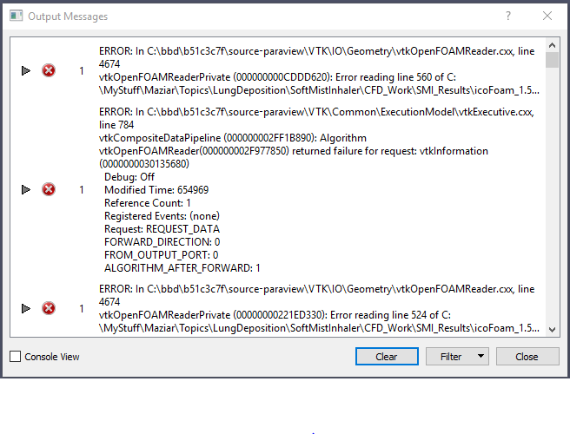
Windows 10. Paraview 4.4.0. Data Input openFoam/case.foam. Case Type: Decomposed Case

Slide 2
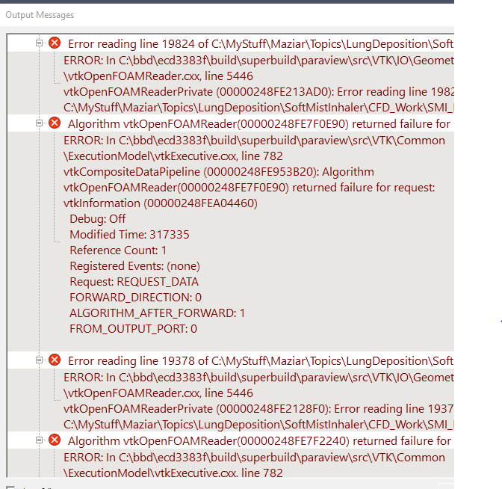
Windows 10. Paraview 5.6.0. Data Input openFoam/case.foam. Case Type: Decomposed Case

