Slide 1
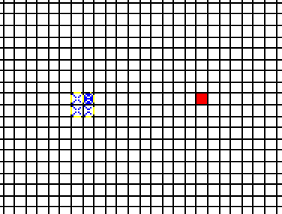
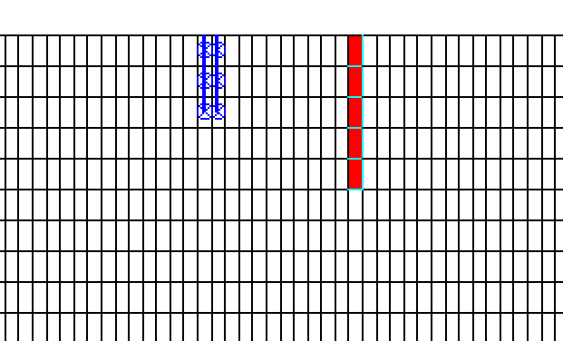
4 wells in layers 1, 2 and 3, each pumping 25m3/day. So the total pumping discharge is 100m3/day.
A high conductivity (Kx=Ky=32000m/day, Kz=0.1Kx) point located 1m away from the highlighted pumping well (in fig1). Kx=ky=1000m/day while Kz=0.1Kx in all other places
The high K point is in layers 1 to 5. Its X and Y co-ordinates are (597.65m, 596.65m)
The grid size in the area shown in two figs is 0.1m. A total of 20 layers in the model each 1m thick. Top elevation of 1st layer is 1m, 2nd is 0m, 3rd is -1m and so on. The bottom elevation of last layer is -19m.
Pumping well
High K point
Fig1. Plan view
Fig2. Cross-section view

Slide 2
Figs. Expected flow vector diagrams in plan and sections

